Slide 1
FLIPS
Fast & Low cost Image Processing System
Version 3.9.0.0
General Guide
General Guide/User‘s Manual
-Article 22, Edition -
I. Brief Description
II. settings, manual operations
III. external control
2023-02-02
Second Division, Production Engineering Department, Fukushima Canon Inc.

Slide 2
I. Brief Description
1. Concept ――――――――――――――――――
2. Example System Configuration ――――――
3. What you can do with FLIPS ―――――――
4. FLIPS Featured Features ―――――――――
4.1 Fast Mass Processing ――――――――――――
4.2 Shading Correction ―――――――――――――
4.3 High-Resolution Camera Support ―――――――
4.4 Angle Detection for Pattern Search ――――――
4.5 Code Reader, OCR ――――――――――――――
3
5
6
10
10
11
12
12
13

Slide 3
I. Brief Description
Concept
FLIPS is cheaper, easier and more convenient than other image processing systems
 | Price (Buying, running) | Function (O: Basic, ◎: Special) | FTE (development and start-up) | Security (Hedging diversion risk)
FA Camera (Keyence) | × | ◎ | 〇 | △
LabVIEW | × | 〇 | 〇 | △
Board System (HALCON) | × | ◎ | × | △
CRAVIS-mini | 〇 | 〇 | × | △
FLIPS | 〇 | 〇 | ◎ | ◎
Cheap … Basic configuration completed with webcam and PC only
Easy … No programming required, just set parameters
Standard equipment limited to frequently used functions
Convenient … Just connect a USB cable or a LAN cable to the hardware.
Only copy and paste the folder containing the application
in the software.
Camera purchase cost: from 1,000 yen
Mouse operations only
No complex configuration
Complete all on one screen
No tools needed
No installation required
Drawing complete in 1 second

Slide 4

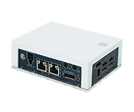
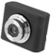
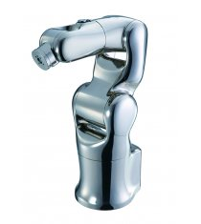
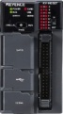
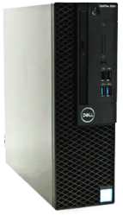
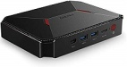

I. Brief Description
2. System configuration example
The body of FLIPS is software!
Change hardware mix to suit your needs
① Manual and semi-automatic devices
② Automatic assembly and inspection equipment
FLIPS
"Screen click"
Or
Start with "USB button"
FLIPS
IN
IN
RS232C
or
Ethernet
Commercially available
USB cameras
USB
PC/PLC/Robot
external controller
USB
Commercially available
USB cameras
PC for FA: 100,000 yen
Equipment power interlocking
(* Power button can be disconnected)
User Existing PC: \0
Or
Standard laptop: 60,000 yen
USB
DIO
USB
IO units: 30,000 yen
LAN
DIO
By BIOS settings
Equipment power interlocking
Arduino: 5000 yen
③ Line and cell production equipment
④ Image data processing
FLIPS
FLIPS
FLIPS
FLIPS
FLIPS
IN
IN
IN
IN
IN
Mini PC: 20,000 ~ 30,000 yen
No camera, just image file (Data) processing

Slide 5
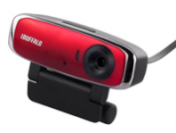

I. Brief Description
3 What you can do with FLIPS
3.1 Settings, switching functions
・Automatic connection and switching of 0 ~ 9 cameras (external communication/mouse operation)
(* Use an external power USB hub when using multiple devices)
(* Images can be loaded and tested without a camera)
・Register 0 ~ 999 Settings
All settings on the next page (list of basic functions) can be saved in 1000 patterns and switched.
Camera 01
Setting No.
000
001
002
:
999
Camera
1
2
:
:
9
Setting No. 01
Camera
1
2
:
:
9
Setting No.
000
001
002
:
999
Switch between 0 ~ 999
settings for 1 camera
1 ~ 9 cameras
with 1 common setting
Use separate settings
for multiple cameras
Any is possible

Slide 6
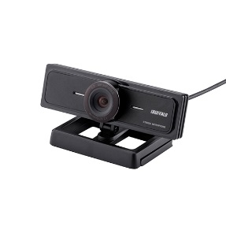
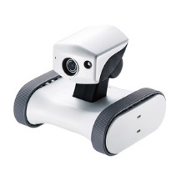
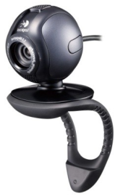

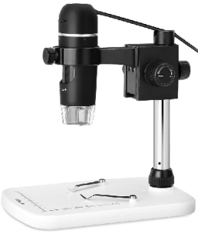
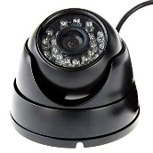
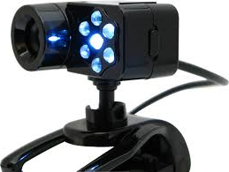
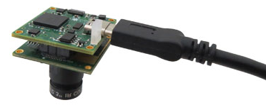
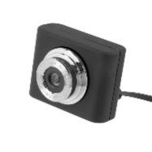
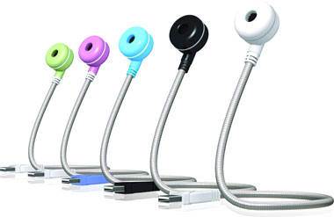
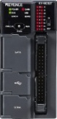
I. Brief Description
Cheap! Easy! Convenient! New types of image processing systems
Commercially available USB cameras
App screen
PC for FA with power button off OK (no shutdown required)
*Can be used on standard desktops, laptops, etc.
PC
RS232C
or
Ethernet
・You can connect up to 9 webcams. (UVC specification)
・It is possible to mix different manufacturers, and you can choose freely according to your use and purpose.
(Close-up: x 10 to x 300, LED lighting, interchangeable lens type, etc.)
・There is no need for a driver or anything.
・In addition to the usual image processing, functions such as
"video recording," "barcode/QR code reading" and "OCR" are standard equipment.
・If you don't have enough USB ports, use a USB hub. (\200~\4,000)
・Use a USB extension cable when the cable is short.
・USB cameras are inexpensive, and here's a rough guide:
1.2 million pixels: 1,000 yen 2 million pixels: 3,000 yen 8 million pixels: 10,000 yen
external controller
PLC, PC, Robot Controller ・・・
Copy the entire folder of apps onto your PC, plug in a USB camera, and you're ready to try it out!

Slide 7
I. Brief Description
3 What you can do with FLIPS
3.2 List of basic functions
◆ Input image manipulation
・Camera resolution selection (setting range depends on camera specifications)
・Image size settings (magnification: x 1.0 to x 9)
・Capture Area Settings
・Image Flip (Flip Horizontal/Flip Vertical)
・Angle correction (+ 180.0 to -180.0 degrees)
・Exposure Adjustment (Automatic/Fixed)
・brightness adjustment
・Perspective Adjustment
・Gamma Correction (0.3 ~ 0.7)
・Contrast Enhancement (0 ~ 9)
・Sharpen correction (Yes/No)
・Hue Adjustment (0 ~ 360 degrees)
・Saturation (-1.0 to + 1.0)
・Manual loading of arbitrary images (can process images without camera)
◆ Code Reader
・Automatically determine and read code type
(Various bar codes and two-dimensional codes)
・Read Action Settings (Continuous/OneTime/OneShot)
・Output Characters Read
・Character limit to read
◆ external control
・Ethernet socket communication, RS 232 C communication, File communication
・Various commands are available such as camera switching, setting switching, etc.
・Reading and processing arbitrary image files
◆ Other
・Saving Arbitrary Images Manually
・Automatic image saving (Destination, File format specifiable)
・Automatic measurement of image processing time
・Switch screen size, save screen position
・Protecting Settings with a Password Lock
・Internal flow control (16 patterns) registration
・Various arithmetic and output functions with flow control
・Interaction with external power supply (PC shutdown)
・Setting the Delay Time for Camera Device Recognition
・FLIPS multiple boot permission settings in the same PC
◆ Image Processing
① pattern search
・correlation value lower limit specification
・Existence judgment
・XY.THETA. position measurement (where .THETA. is in units of 0.1 degrees)
・XY theta area position correction (Color extraction, difference, binarization, OCR)
② color extraction
・Color extraction with RGB or HSV components
(color palette/mouse-click/numeric input specification)
・color-difference tolerance specification
③ Differential extraction
・Difference extraction tolerance specification with registered image
・Differential extraction of real-time images from smoothed images
④ Measurement and judgment in binarization processing
・Position correction of XY.THETA. by pattern search (enable/disable)
・Shading correction (yes/no)
・Area designation by dragging the mouse (can be entered numerically)
・Copying, adding and deleting areas
・Black and White Flip by Area
・Area binarization level settings (automatic/manual)
・Various filtering by area
(Blur 3 types 5 levels, Inflate 3 levels, Shrink 3 levels, Sobel)
・Maximum and minimum judgment settings for each area
(Measured value output when judgment setting is not available)
・Measurement (judgment) type setting for each area (total area/blob area/
Edge position/Edge width/Number of blobs/Centroid position of blobs)
⑤ OCR
・Character reading (English/Japanese)
・Character recognition (Consistency: 10 types Contained: 5 types)
・Read mode specified (Vertical, single line only, single character ・・・)
・Register White List

Slide 8
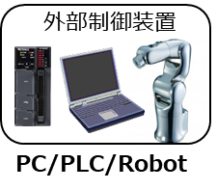
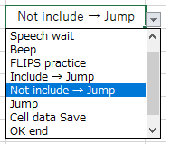
I. Brief Description
3.3 Input/Output Functions
< Input > External command input allows you to switch cameras and settings, start image processing, etc.
Either Ethernet, RS -232 c, or FTP (File) can be used for communication (mixed use is also possible)
See "III. External Control" for the actual command
< Output > "Overall judgment result," "Individual judgment result" and "Measured value result" are output as "letters or numbers."
Select "RAW/After processing" and "NG only/All" to automatically save images to any folder or server
Select image format from "Bmp/JPg/Gif/Png" (only "AVI" for video)
◆When multiple types of inspection are performed by switching multiple cameras and settings by external control,
the sequence flow can be constructed on the external control side as follows to construct complex and diverse algorithms.
External Controller
Camera, setting instructions
Image processing results
Camera, setting instructions
Image processing results
FLIPS
judgment, branching
judgment, branching
◆If you want to control it externally from another PC or from another app in the same PC,
you can use the free "Generic external control software: FLIPS _ EXT.xlsm" separately from the FLIPS console
without having to create a communication and control app from scratch.
This is an Excel file with macros, so you can select pre-registered commands from within the box of a cell, write parameters, sequence flow
without writing any code, and communicate with FLIPS instantly.
Unique functions such as text-to-speech using Excel's text-to-speech function are also included as standard,
and since the program is written in VBA macros, you can freely add and change equipment and process-specific processes.
behavior selection

Slide 9
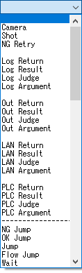
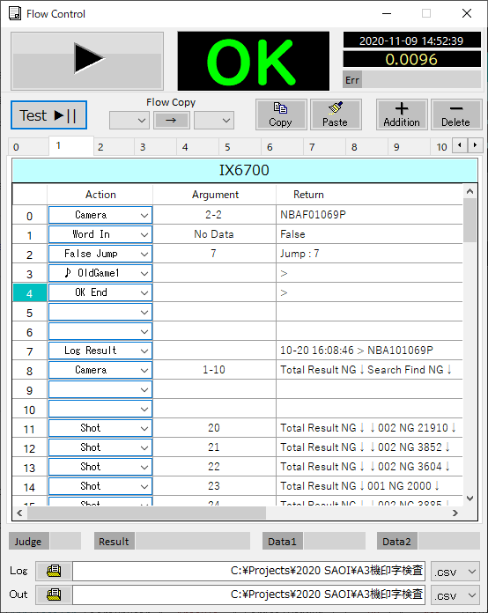

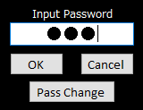
I. Brief Description
3.4 Flow control function
There is a function to make sequence flow even inside FLIPS, and 16 different settings of No .0 ~ 15 are possible.
You can control multiple camera switches and settings at once, as well as save and output results in fine detail.
You can also control the flow itself by calling it from outside with a command.
Flow number
external controller
Flow execution instructions
[ F** ]
Image processing results
PC/PLC/Robot
3.5 Password lock function
Password lock prevents accidental configuration changes by non-engineers

Slide 10
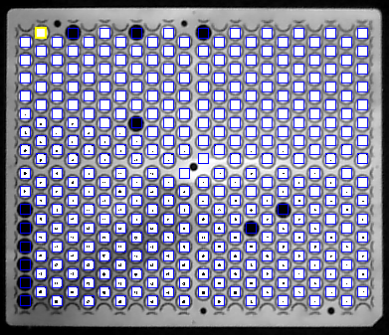
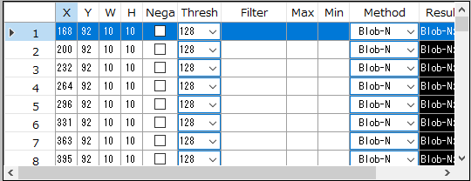
I. Brief Description
4. Special Features of FLIPS
4.1 High-speed mass processing
(Example)The presence or absence of spur seats - Full inspection
Outputs 1 or 0 results with or without 330 locations
Inspection parameter list
◆Easy configuration of inspection parameters
・Easy area setting with mouse drag or numeric input (but not circles, polygons, etc.)
・Individually configurable for each inspection window, including various filters and binarization levels
・It is easy to set up because it is listed even in a hundred inspection windows
(difficult to operate with commercially available general purpose equipment).
◆Faster processing associated with faster PCs
(e.g., presence or absence of 330 workpieces on a sheet - judged by 0.4 seconds (0.001 seconds/piece))
* Depends on PC specifications

Slide 11
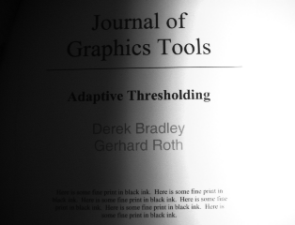
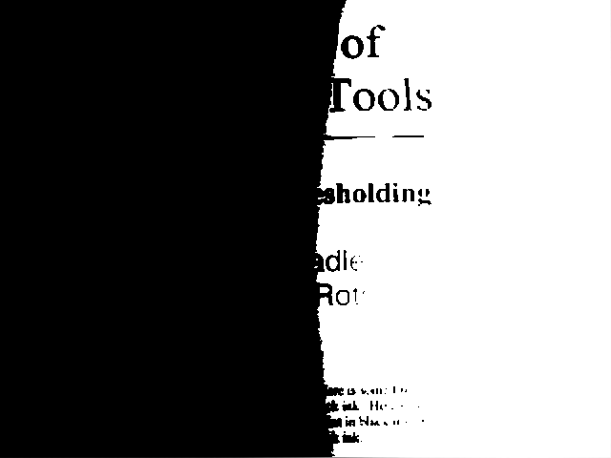
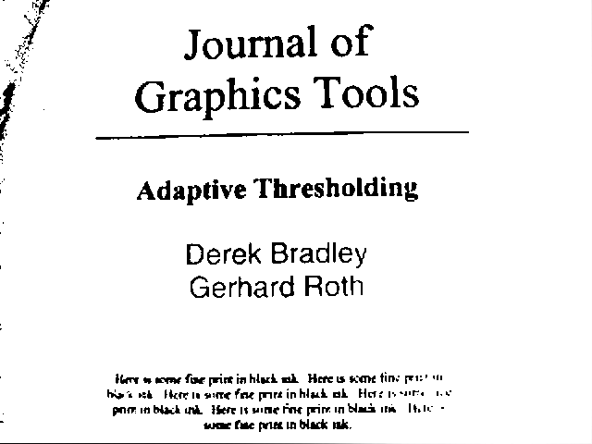
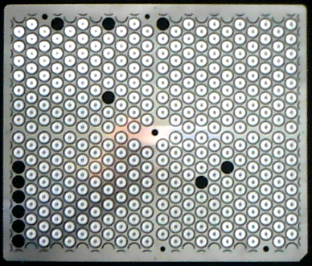
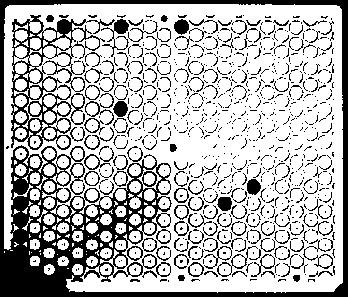
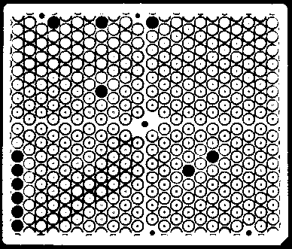
I. Brief Description
4. Special Features of FLIPS
4.2 Shading correction
◆Unevenness is removed by a special averaging process with one click from an image
with uneven density caused by lighting, etc.
Original image
normal binarization
Shading binarization
Original image
normal binarization
Shading binarization
One click

Slide 12
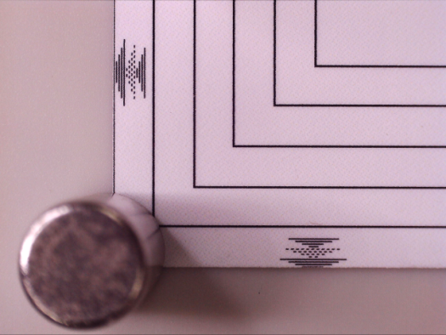
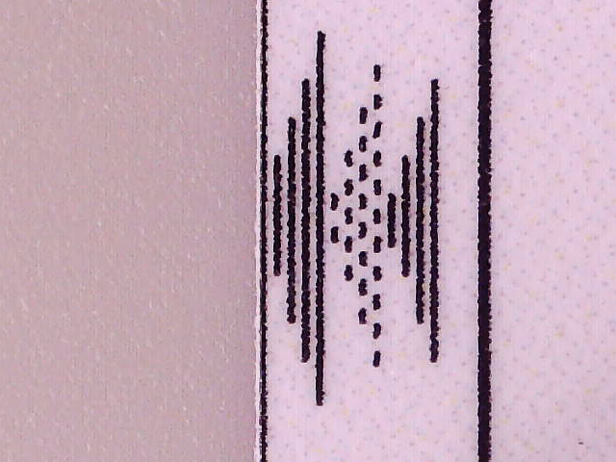
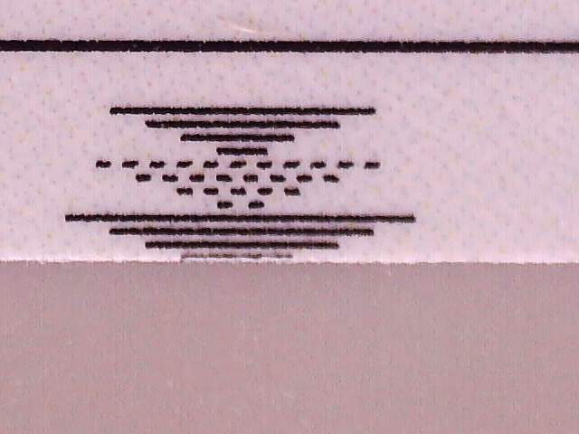
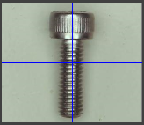
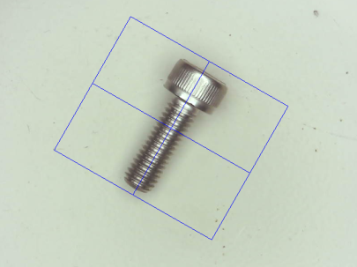
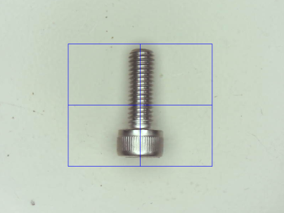
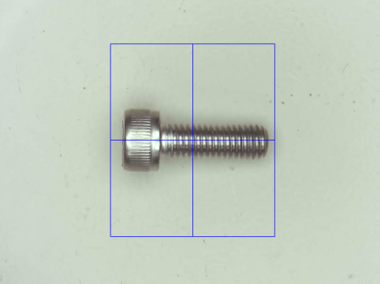
I. Brief Description
4. Special Features of FLIPS
4.3 High-resolution camera support
◆High-pixel camera images can be processed at maximum quality without slowing down
(Example: Using a 22 million pixel document camera to process images for print inspection of an A3 printer)
While maintaining a broad perspective
(Images can be processed with this wide field of view.)
Switch to the area you want to see each one, and get high image quality, fast processing
(Exerts maximum performance of high-resolution cameras)
4.4 Angle detection and angle correction for pattern search
◆Angle detection with "accuracy" and "speed" similar to "paid image processing library"
The OSS OpenCV and Aforge don't have an angle detection function by nature, but they do it with their own algorithms.
+/- 180 degrees At any angle, measurement and correction in units of 0.1 degrees are possible in approximately 0.1 seconds.

Slide 13
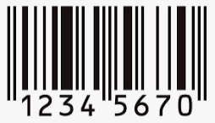
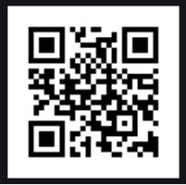
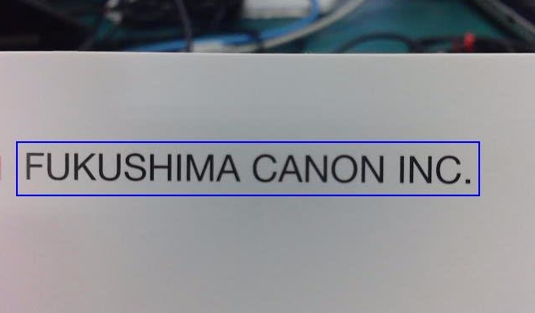
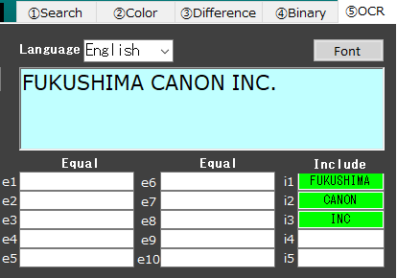
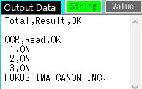
I. Brief Description
4. Special Features of FLIPS
4.5 Code reader, OCR
◆code reader
It can read and output various "barcodes" and "two-dimensional codes."
The type of code is automatically judged and displayed.
You can choose from three types of readings: "1 Shot," "1 Time" and "Endless."
◆ OCR
It can recognize and output English and Japanese characters.
Also, it is possible to judge the compatibility with 10 types of pre-registered letters
and to judge the content of 5 types of letters.

Slide 14
II. settings, manual operations
1 Introduction ―――――――――――――――――――
1.1 Note:―――――――――――――――――――
1.2 Soft Configuration ――――――――――――
1.3 Web Authentication ――――――――――――
2 FLIPS screen, instructions―――――――――――
3 Setting and operation details ―――――――――
3.0 System Settings ―――――――――――――
3.1 Camera selection ―――――――――――――
3.2 Setting selection――――――――――――――
3.3 Setting data――――――――――――――――
3.3.1 Input Image ――――――――――――――
3.3.2 Image Auto Save ――――――――――――
3.3.3 Image Processing ――――――――――――
① Search ―――――――――――――――
② Color ――――――――――――――――
③ Difference ―――――――――――――
④ Binary ―――――――――――――――
⑤ OCR ――――――――――――――――
3.4 Manual Trigger SW ――――――――――――
3.5 View Results ―――――――――――――――
3.6 Switch Image, Load, Save ―――――――――
3.7 Reader mode ―――――――――――――――
3.8 Flow Control ――――――――――――――――
15
15
16
17
18
19
19
22
22
23
24
29
32
33
38
40
44
56
65
66
67
68
69

Slide 15
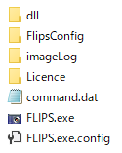
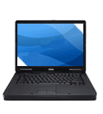
II. settings, manual operations
1. Introduction ・・・
・FLIPS folder configuration
1.1 Caution
☑ FLIPS becomes a "single folder" system
When setting up or moving, please go through the folder by folder.
☑ folder name (FLIPS) and executable file name (FLIPS.exe) can be changed
*Do not change any other file or folder names.
*When you change the name of (FLIPS.exe), change the name of (FLIPS.exe.config) to the same name.
(FLIPS.exe) (FLIPS.exe.config) → (Check01.exe) (Check01.exe.config)
☑ FLIPS V. 1.2. 0.0 and later mainly targets Win 10 For use with Win 7 or lower, install Framework 4.0
or higher (available for free from Microsoft's site) or use a downgraded version of FLIPS
☑ FLIPS can be run over a network However, you can't access the same FLIPS from two PCs at the same time.
In that case, separate the folders and access them separately.
Also, be aware that running on a network increases processing time.
FLIPS
FLIPS(1)
FLIPS(2)
FLIPS
FLIPS
FLIPS
FLIPS(3)
**Port number needs to be
changed to a different
number
(FlipsConfig\ServerPort.dat)
Fast
Not possible
Slow

Slide 16
II. settings, manual operations
1 Introduction
1.2 Soft Configuration
FLIPS
AForge (Accord.NET)
ZXing
OpenCvSharp
Tesseract
.Net Framework
Direct Show
OS (Win 10)
・The OS is developed with Win 10 as the main target, but it has also been confirmed to work with Win 7 and Embedded 7.
It has not been tested in all series, but it can basically run as long as the .Net Framework is 4.0 or higher.
If an error occurs due to the framework, please install at least 4.7 from the Microsoft site.
< Main OSS used >
Aforge ZXing OpenCV Tesseract
*Detailed OSS information can be found in the "License" folder in the FLIPS folder

Slide 17
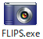
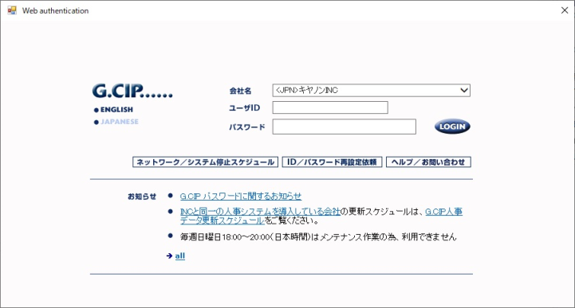
II. settings, manual operations
1 Introduction
1.3 Authentication and Registration
Web Authentication
When using FLIPS, only the first time G.CIP authentication is required
G.CIP Run "FLIPS.exe" with access to CIP
After that, it can work offline.
1. Run "FLIPS.exe"
↓
2. When the screen on the right appears, enter your ID and password
to log in to G.CIP (* anyone's account is OK)
↓
3. The screen disappears and FLIPS starts.
*You'll need to do the same if you want to use it on another PC
ID registration
If you use a PC that is not in G.CIP or want to use it offline,
you can activate FLIPS by registering the product ID of the PC as an encryption key.
1. Check your PC's Product ID
Settings > System > About > Device Specifications > Product ID: XXXXX-XXXXX-XXXXX-XXXXX
↓
2. Send "Product ID" to FLIPS members at Fukushima C (text or pictures are OK)
↓
3. If you put "Encryption key file: Pid.dat" in "FLIPS \FlipsConfig" in reply from FLIPS member of Fukushima C
You will be able to boot offline.
*You'll need to do the same if you want to use it on another PC

Slide 18
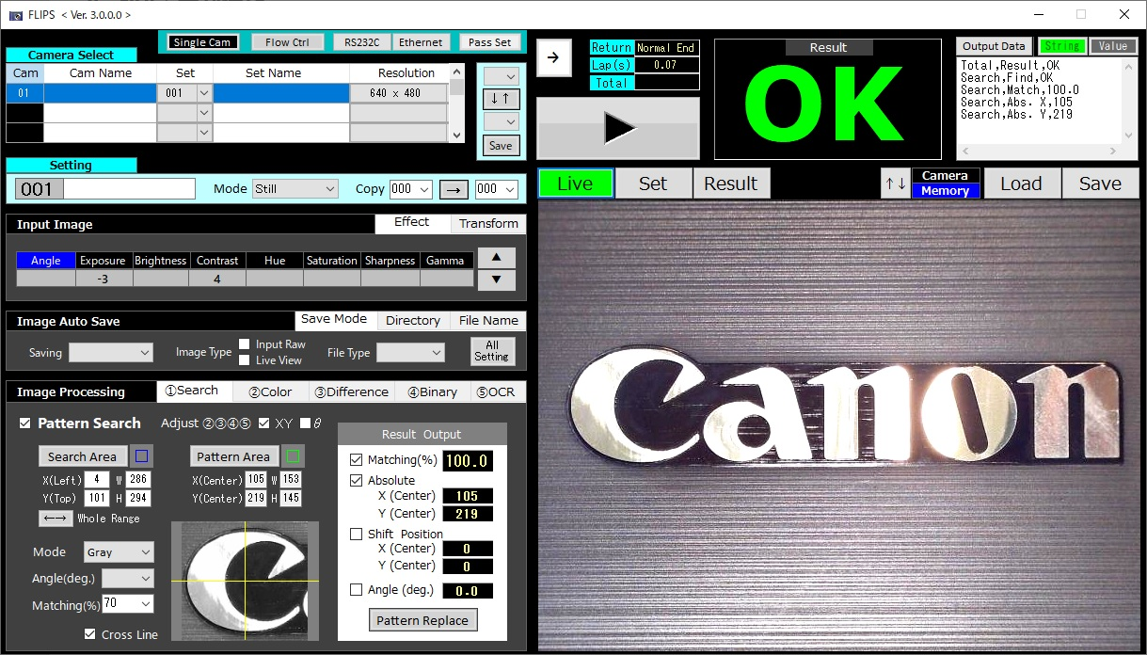
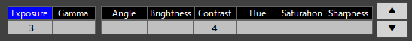
II. settings, manual operations
2. FLIPS screen and operation
◆Basic "Settings," "Operations" and "Monitor display" are complete on this one screen.
0. System Settings
4. Manual Trigger SW
5. Result display
1. Camera selection
2. Setting No. selection
3. Setting data
1. Live Monitor
3. Image processing setting screen
5. Result Image Display
-Schematic Operations -
0. These are system-wide settings buttons for switching camera modes, communication settings and flow control settings.
1. Click to select camera manually
2. Select setting number (can be set for each camera)
3. Make image processing settings (save automatically when you change the setting number or exit the app)
4. Manual Trigger SW (Click to execute image processing)
5. Judgment results are displayed and the screen automatically switches to the screen after image processing
(processing time and external output data are also displayed).

Slide 19
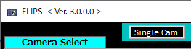
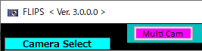
3 Setting and operation details
3.0 System Settings
◆Camera mode
・FLIPS <Ver. 3> and later add a "multi-camera function" to keep multiple cameras active at all times
This greatly reduces the switching time of the camera, making it powerful in visual inspections where multiple cameras are switched.
This function is subject to system configuration requirements, so please understand the following before using it.
・Whereas <Ver. 2> activates a camera and starts image transfer after it has been selected,
<Ver. 3> pre-activates all connected cameras at all times.
For this reason, switching time was reduced to "loading settings" and "transferring to the monitor screen" only.
Click
Click
<Ver.2>, <Ver.3> Single Cam Mode
<Ver.3> Multi Cam Mode
Camera
PC
Camera
PC
Start only selected camera, transfer images
*It takes a long time to transfer the first image
when switching cameras
Start all connected cameras
*Image transfer and image processing are done
by one camera at a time
Switching time: 3 sec
Switching time: 0.8 sec
・When using the multi-camera function, the number of cameras that can be connected is greatly limited.
While the <Ver. 2> has 99 units (theoretically infinite), the <Ver. 3> has a maximum of 9 units,
and under certain conditions can have as many as 3 ~ 4 units.
And those conditions are determined by (1) PC performance (2) camera resolution settings (3) USB configuration

Slide 20


II. settings, manual operations
3 Setting and operation details
3.0 System Settings
◆external communication
・FLIPS allows you to change image processing settings, issue an instruction to start image processing, and receive image processing
results by controlling them from an external device (PLC, Robot, PC).
This control can be communicated in the following ways:
1. TCP/IP
2. RS-232C
3. File communication
*If you do not use them and directly trigger with a hard SW, you will need an "external IO unit" and additional programs.
*If you want to communicate with another app in the same PC as FLIPS, "2. RS -232 C" is not suitable because a separate communication cable is required.
In that case, we recommend using "1. TCP/IP" "3. File communication."
All three methods are always on standby (so you can use them in combination at the same time).
Each has a different hardware, but the command protocol (interaction procedure) is exactly the same.
※For details on external control,
see "III. External Control" below.

Slide 21






II. settings, manual operations
3 Setting and operation details
3.0 System Settings
◆Password lock
・If you click Pass Set, you can enter a password to lock the settings data change.
*Only changes to the settings data can be locked, and screen switches and trigger buttons (▶) can be used normally.
Locked state
・Click Security and enter your password to unlock the change lock on your settings data
*If you forget your password, please contact the developer.
・Once Register password, next time Security Just click lock to lock configuration data changes again
・Security After entering your password by clicking Pass Change You can change your password by clicking
If you click OK without entering anything at this time, the password lock setting itself will be reset.

Slide 22




II. settings, manual operations
3.1 Camera selection
・The camera automatically recognizes and connects when the app is launched.
Recognized cameras are numbered in Cam
・You can switch cameras by clicking the number of Cam.
It takes about 2-3 seconds to switch the camera.
(* About 0.8 seconds in multi-cam mode)
(* Since the light is automatically dimmed, it can be controlled externally as well.)
・Up to 9 cameras can be connected.
(* Select an "external power supply" type when using a USB hub)
・In the Cam Name field, you can write the name of the camera, etc., and use it as a note.
・In <Ver. 2>, camera resolution settings could be set for each "Setting No,“
but in <Ver. 3>, resolution is set for each "Camera No.".
You can manually change and save camera resolution settings, but you can't switch them from the outside.
Basically, use the same resolution on the same camera.
*The higher the number of pixels, the higher the image quality
but the slower the processing speed, so it is sometimes better to reduce the number of pixels
when inspecting moving objects.
・When there are multiple cameras, the camera numbers are automatically assigned in the order of the USB device names, but you can change this with the ↑↓ button.(Also swappable with unconnected camera numbers)
Also, if you save with the Save button, you can lock all camera numbers.
*In the automatic recognition of the PC, the camera number may change due to the UBS connection order and the fast and slow power supply.
The Save button associates the camera information with the USB port, so you can always reproduce the same camera number.
Camera selection
Swap Camera
*The resolution selection list is a camera-specific setting
and will be different for different types of cameras
3.2 Setting selection
・Select the number (000 ~ 999) from the box of Set to switch the setting
・The setting switch time is 0.0 to 0.3 seconds (depending on the amount of setting data).
・You can also use the same setting number for multiple cameras.
・Settings can be registered by name and can be used as notes such as model names.
(* The name of the setting is written in the setting data on the next page.)

Slide 23

II. settings, manual operations
3 Setting and operation details
3.3 Setting data
◆All Input Image, Image Auto Save, and Image Processing settings are saved individually for each setting number.
(Including reference registration images used for pattern search, etc.)
Choose a mode from "Still" or "Reader"
・Still : Still image processing
・Reader: Barcode, 2-D code reading (see 3.7 Reader Mode for details)
Settings can be registered by name
and can be used as notes such as model names.
After selecting the source/destination numbers, click "Right" to display a confirmation screen, and click "OK" to transfer the entire setting.

Slide 24




II. settings, manual operations
3 Setting and operation details
3.3 Setting Data
3.3.1
Input Image
◆Pre-processing before processing images captured from the camera
Click here to select a parameter and use ▲▼ to change the value
Exposure and Gamma are controlled relative to the camera body
Everything else, including Transform, is done on the captured image.
Therefore, for those loaded with image files, Exposure and Gamma have no effect
Other than that, the input image from the camera and the file image have the same effect.
Exposure
Corrects exposure in the range of -1 to -9
Auto dimming is used for Auto.
-5
Auto
-2
Use the "Exposure" function only after fully understanding the characteristics of your USB camera.
*Exposure: Auto dimming takes 2-3 seconds immediately after camera switching during Auto(varies depending on the camera used and the amount of outside light at the time)
In addition, white balance may take some time to adjust automatically.
Exposure: When using a numerical value (Manual), since there is no dimming time, it is advantageous tact if you frequently switch between workpieces
or cameras with different brightness.
*Be careful when switching Exposure from "Auto" to "Manual"
If you switch from "Manual" to "Auto" when the brightness has been corrected by auto dimming, the correction will be added and the brightness will be shifted.
(When "Auto" is selected, if the target is dark, it will be bright when switched to "Manual," and if it is light, it will be dark when switched.)
The only way to reset this correction is to unplug and re-plug the camera's USB cable.
(Once you plug it back in, the camera image disappears, but if you switch to a different camera in Single Cam mode and then switch back to that camera,
you're good to go.)

Slide 25







II. settings, manual operations
3 Setting and operation details
3.3 Setting Data
3.3.1 Input Image
Gamma
Gamma correction at 0.3 ~ 0.7
Normal
0.5
*Exposure and Gamma only work on input images from the camera
Note that it does not affect the image on which the file is loaded.
FLIP
[Mirror] Flip image horizontally
[Up/Dw] Flip image upside down
If you attach a side view mirror as a lens
attachment, the image will be inverted.
In that case, you will not be able to read "OCR,"
"barcode" or "two-dimensional code," which reads
characters, so we will use them for correction..
Mirror
Up/Dw
Side View Mirror
Angle(°)
Real-time processing of image rotation from -180 degrees to + 180
degrees in 0.1 degree increments
(blank is 0 degrees)
If you press and hold down the ▲▼, you will see steps of - > 1 - > 10.
You can change the angle at high speed.
0°
-25°
*Other than 0 and +/- 180 degrees, there may be a delay in the display of the image
(The higher the resolution, the greater the delay.)

Slide 26


















II. settings, manual operations
3 Setting and operation details
3.3 Setting Data
3.3.1 Input Image
Brightness
Corrects brightness in increments
of 10 in the range of -90 to + 90
*Blank is zero, no correction
*Brightness can be changed even
when Exposure is Auto.
-40
0
+40
0
+30
+60
+90
Contrast
A value of 1 ~ 9 increases the contrast
Sharpness
When turned ON, the edges are enhanced
and the image appears to be in focus.
Normal
ON
Hue
Changes the hue in 1 degree increments
in a range of 0 ~ 359 degrees
* Blanks are not corrected and are different
from 0 degrees.
* The black and gray areas in the image on
the right have no hue, so they have not
changed.
Normal
0
60
120
180
240
300
Saturation
Corrects saturation in increments of 0.1,
ranging from -1.0 to + 1.0
* Blank is zero and not corrected.
Normal
-1.0
+1.0
If you want to ignore the color information,
set it to -1.0 to process it as a gray image.

Slide 27


II. settings, manual operations
3 Setting and operation details
3.3 Setting Data
3.3.1 Input Image
Mag(Input)
The magnification of the camera's input pixels to the image display area (X: 640 pix)
It reappears automatically when the camera switches, etc.
For a 2 Mpix camera, X: 1600 pix divided by 640 pix → 2.5
For a 5 Mpix camera, X: 2600 pix divided by 640 pix → 4.1
Mag(Set)
Sets the magnification of the processing area relative to the camera's input image
If blank, display and process the full area of the camera input
Resolution: Stays the same when 640 x 480, but otherwise appears compressed or enlarged
When set to "+," the center 640 x 480 pixels are cropped from the camera's input image and displayed.
It can process images with the same resolution as the camera's input image.
If you set a value greater than Mag Input, the camera's input image will be magnified even more.
In this case, the image will be grainy and the delay may be noticeable depending on the camera.
If you set a value smaller than Mag Input, the image will appear smaller than the camera's input image,
but there may still be a delay depending on the camera.
If you set the same value as Mag Input, it will be displayed at the same resolution as the camera's input image,
making the most of the camera's resolution.
The magnification is the same as "+," but you can specify the starting position in Area (%) XY..
*A USB camera of a generation ago will be 1.0 no matter what Mpix it is.
Camera input image (1600 pix)
Displayed image (640 pix)

Slide 28











II. settings, manual operations
3 Setting and operation details
3.3 Setting Data
3.3.1 Input Image
Area(%) X Y
Set the center XY of the Full Frame of the captured image as (50%, 50%) and the center of the display area as XY(* Changed from v 1.5)
When the Mag Set setting is set to "Blank" or "+," the display is centered, so it is effective only at other times.
Full Frame of captured images
Display area
(Image Processing Area)
X:0% 50% 100%
Areas outside the Full Frame are hidden
「+」「-」
Perspective adjustment of display area (* v 1.5 or later)
Scale the XY of the 4 corners of the displayed image by -90 to + 90 pix * There is a delay in the display except when all the settings are 0.
Original image with perspective
Correct by shortening Y on the left side
Longer Y on right side to correct
(Reference)

Slide 29





II. settings, manual operations
3 Setting and operation details
3.3 Setting Data
(* Below, Camera mode: Still)
3.3.2
Image Auto Save
Make settings for automatically saving the original image after image processing
Saving
(Blank)/Result: Choose from NG/Every time
Blank to not autosave
If you select [Result: NG ] the image will be saved only when it is judged NG.
Select [Every time] to save an image each time a trigger is triggered
Image Type
If [Input Raw] is checked, the raw image captured by the camera will be saved as is.
The image size will be the size of the resolution set in [Resolution].
*If you want to recheck, you can do it just by reading this saved file.
If [Live View] is checked, images enhanced with [Input Image] will be saved
The image size will be (640 x 480).
*If you read and reinspect this file, you must ensure that the image processing in Input Image
is not doubled.
*Result Image (processed image) which could be saved before has become unselectable
since Ver. 2.0. 2.1
File Type
Select the image format from Bmp/JPg/Gif/Png
All Setting
Click to display a confirmation screen and say OK to apply this setting to all current settings
Input Raw
Result Image

Slide 30


II. settings, manual operations
3 Setting and operation details
3.3 Setting Data
Directory
Set where to save the image
You can click the folder button to specify from the tree
A folder of "Year _ Month" will be automatically created in the specified destination
and the image files will be saved in it.
*To save to another PC, set "Permissions" or "Share folder."
*If you delete the destination and leave it blank,
the folder containing the FLIPS effective file (.exe) becomes the destination.
All Setting
Click to display a confirmation screen and say OK to apply this setting to all
current settings

Slide 31

II. settings, manual operations
3 Setting and operation details
3.3 Setting Data
Initial Char
You can set a string to be added at the beginning of the name of the image file to be saved
If you add a process name or a work model name, it will be easier to understand later.
The file name will be something like "Initial Words" + day, day, day, hour, minute, second, second. "Type"
☑ (Camera)
If checked, the camera number will be appended to the name of the image file to be saved
(If you set "Cam Name," it will be added as well)
☑ [ Setting ]
If checked, the Setting number will be appended to the name of the image file to be saved
(If you set "Set Name," it will be added as well)
☑ “_NG”
When checked, if the result of the judgment is NG, the character "_ NG" will be added to the name of the image file to be saved.
Test
Click the Test button to display a sample file name in white text at the current time
*Images will not be saved
*If an image was saved by Auto Save, the name of the saved file will be displayed in yellow text here
All Setting
Click to display a confirmation screen and say OK to apply this setting to all current settings

Slide 32


II. settings, manual operations
3 Setting and operation details
3.3 Setting Data
3.3.3
Image Processing
Image processing is performed in the order of (1) - > (2) - > (3) - > (4) - > (5). Click each tab and set each
*When (2), (3) and (4) are executed, the effect is applied to the image and the effect image is carried over to the next process.
*For (1), the Θ correction effect is applied only when "Adjust (2) (3) (4) (5) ☑ theta."
① Search ・・・・・ Pattern Search: Detects similar parts to a pre-registered image (pattern) in a set area
② Color ・・・・・・ Extract specified color components from image
③ Difference - - Extracts the part where there is a difference from the pre-registered image
④ Binary ・・・・・ It will be binarized, and the measurement and inspection content will be specified and judgment value will also be set here.
⑤ OCR ・・・・・・・ Character recognition, matching judgment between output and registered characters, content judgment

Slide 33





II. settings, manual operations
3 Setting and operation details
3.3 Setting Data
3.3.3 Image Processing
① Search
① Search ・・・・ Pattern Search: Detects similar parts to a pre-registered image (pattern) in a set area
☑ Pattern Search
If checked, execution If not checked, it will be non-execution
Search Area
When clicked, the button changes color and allows you to specify a search area on the "Set" screen with the mouse.
Move the mouse cursor to the start point, right-click, continue moving the mouse and releasing it at the end point
Set the search area with the mouse or click the "Search Area" button again and the color of the button will return
You can also specify the area directly by number. (* Numbers are in units of "pixels" and the upper left is 0,0)
Look for registered images in the area set here
You can specify the whole area by clicking the Whole Range button
Pattern Area
As with Search Area, use the mouse to specify the area
As soon as the area is set (as soon as you release the right click), the image is registered and displayed in the tab.
Look for the image set here in the range of the search area (* The value is in units of "pixels" and is the XY center of the registered image.)
Click a button to switch the border width between 2 pix/1 pix each time
Double-clicking also displays a color palette where you can change the color of the border.

Slide 34




II. settings, manual operations
3 Setting and operation details
3.3 Setting Data
3.3.3 Image Processing
① Search
Matching(%)
Set the correlation value of the registration pattern
The higher the number, the more strictly the same
image will be searched, and the lower the number,
the greater the tolerance.
Binary
(blank) finds the single most similar pattern in the input image to the registered "color image"
Gray/Binary detects registered and input images in the same way,
Color images have a large amount of data and take a long time to process when detecting angles,
but Gray/Binary mode enables fast processing. (Binary's binarization level is Auto and Bin 1 ~ 254 is its threshold)
After binarizing, the Bin W- 1 ~ 5 and Bin B 1 ~ 5 undergo expansion and contraction processing for each numerical value.
*In Gray/Binary mode, you will no longer be able to determine the matching by color difference
*Even when Gray/Binary mode is used, the displayed image and the image carried over to subsequent processing
is the original color image.
Filter
If a numeric value is specified, that amount will be added to the registered image
and the input image respectively.
Depending on the target image, the correlation value may be higher when the "blur effect" is added.
*Images with "blur effect" added to subsequent processes will not be retained
Angle(deg.)
Specifies the angular range to detect. If you leave it blank, angle detection will not be performed.
*The actual detectable angle is different from the range of angles set here.
Blank, for example, does not perform angle detection, but by reducing the Matching (%) value,
it is acceptable and detectable even if it is slightly angled.
Point(25 <)
The feature quantity of the registered image is displayed in points.
When performing angle detection with "Angle (deg.)," the more points there are, the more accurate the detection will be.
(irrelevant when angle detection is not performed).
If the point is less than 25, the angle detection time is greatly increased.
In that case, you can reduce the detection time by setting the minimum angle range of "Angle (deg.)" as in "+/- 10 degrees."

Slide 35






II. settings, manual operations
3 Setting and operation details
3.3 Setting Data
3.3.3 Image Processing
① Search
☑ Cross Line
If checked, crosshairs will be displayed on registered and detected images
Each time you click on a registered image, the width of the crosshairs will be switched to 2pix/1pix
Double click to display a color palette where you can change the color of the crosshairs.
Adjust (2)(3)(4)(5) ☑ XY
By executing the pattern search, the difference between the position when the pattern was registered: X (Center) Y (Center) and the position
found in the input image: Absolute X, Y: Shift Position X, Y is calculated.
If Adjust XY is checked and executed, the frame (area) set by OCR will be shifted by Shift Position X, Y ② Color ③ Difference ④ Binary ⑤.
With this, even if the camera or work is moved, the inspection frame can be moved to follow the object by the same amount.
Adjust (2)(3)(4)(5) □XY
Adjust (2)(3)(4)(5) ☑XY
① Search Area
① Search registration position (4) Binary setting position
Registered Image Move
Binary position unchanged
Binary Position Following

Slide 36









II. settings, manual operations
3 Setting and operation details
3.3 Setting Data
3.3.3 Image Processing
① Search
① Search Pattern
⑤ OCR Area
Adjust (2)(3)(4)(5) ☑ θ
When performing a pattern search, if Angle (deg.) is set (not blank), the detection angle will be displayed in ☑ Angle (deg.) in Result Output.
If Adjust Θ is checked, the image is rotated around the center of the detected pattern by the detected angle.
(While Adjust XY shifts the inspection frame of ②③④⑤, Adjust Θ shifts the image.)
NG
±20
±20
±20
Since the image is tilted but "Angle" is not set, the correlation value becomes low and NG
Show the XY location of the highest correlation value, though not exact
When "Angle" is set, it detects angles in 0.1 degree increments within that range.
The correlation improves as much as when the image is not tilted.
When “Adjust XY” is checked, the XY of the inspection frame set in ②③④⑤will follow.
However, if the image is tilted, it will be out of character like ⑤ OCR setting area (blue frame) in this example.
If you check "Adjust Θ," the image itself will be rotated.
*If you want to detect a pattern that doesn't distinguish between the top, bottom, left and right, it's better not to set "Angle" to prevent unnecessary rotation.

Slide 37



II. settings, manual operations
3 Setting and operation details
3.3 Setting Data
3.3.3 Image Processing
① Search
Result Output When checked, the result of the item will be added to the output data
☑ Matching(%)
It shows the correlation value between the detected image and the registered pattern, and the higher the value, the higher the match.
When Output Data is, Value or, the display remains as it is, but the output data is rounded to the nearest whole number.
☑ Absolute
Displays the detected image's XY center position in pixels
The absolute position of the camera's angle of view, with the origin (0,0) at the upper left
☑ Shift Position
Displays the difference, in pixels, between the XY center position of the detected image and that of the registered pattern image
With the XY center of the registered image as the origin (0,0), the right direction -- > is the relative position in the X plus direction and the down direction -- > is the relative position in the Y plus direction.
☑ Angle(deg.)
Displays the angle of the detected image "0.0" fixed if the angle range setting is blank
When Output Data is, Value or, the display remains as it is, but the output data is rounded to the nearest whole number.
Pattern Replace
Click to reposition the registration pattern to the current position by X (Center) Y (Center) without changing the image of the registration pattern
Shift Position X, Y is zero-reset
+X
+Y

Slide 38










II. settings, manual operations
3 Setting and operation details
3.3 Setting Data
3.3.3 Image Processing
② Color
② Color ・・・・・ Extract specified color components from image
☑ Color
If checked, execution If not checked, it will be non-execution
RGB
Color components can be specified numerically (0 ~ 255)
The specified number can be seen in the actual color
Click the pen button to switch to the color extraction mode,
then click the "Set" screen to capture and specify the color of that location.
You can also double-click the designated color display area to display
a color palette in which you can specify an extraction color.
Radius
Tolerance for color detection. The higher the value, the more acceptable, and the smaller the stricter
Set screen click
Double click
Radius:100
Radius:150
Radius:100
R:225
G:0
B:0
R:225
G:0
B:0
R:225
G:30
B:90
Extract only the red component
By increasing the Radius, even subtle reds are extracted
The Radius is the same, but it extracts a specific red by slightly increasing the green and blue components.
HSV
Based on the Hue, Saturation and Value elements, color extraction is performed.
Compared with "RGB," "HSV" may be able to extract colors that are closer to human color senses or more
resistant to changes in ambient brightness.
Use it according to your target.
HSV Width
Sets the hue width. In FLIPS, hues are expressed in 0 ~ 360 degree angles, and the extraction width is set
in plus or minus angles around the value of H. Therefore, a higher HSV Width value will allow closer
colors, and a lower value will be stricter
brightness
Value
Hue
Hue
Saturation Saturation

Slide 39

II. settings, manual operations
3 Setting and operation details
3.3 Setting Data
3.3.3 Image Processing
② Color
Check Area
When clicked, the button changes color and allows you to specify the color extraction area on the "Set" screen with the mouse.
Move the mouse cursor to the start point, right-click, continue moving the mouse and releasing it at the end point
Set the color extraction area with the mouse or click the "Check Area" button again to restore the button color
You can also specify the area directly by number. (* Numbers are in units of "pixels" and the upper left is 0,0)
Extracts registered colors from the area range set here
You can specify the whole area by clicking Whole Range
Click a to switch the border width between 2 pix/1 pix each time.
Double-clicking also displays a color palette where you can change the color of the border.
*①Search If Adjust ②③④⑤ is checked in Search and a pattern search has already been performed
and there is a difference between the registered image position
and the current set image position (Shift Position X, Y is non-zero), the area specified here will be shifted by that amount.
Therefore, in this condition, when you specify the area,
a confirmation message appears asking whether to "Pattern Replace" as shown on the right.
Click "OK" to execute "Pattern Replace" and make the current pattern detection position
the new reference position.

Slide 40












II. settings, manual operations
3 Setting and operation details
3.3 Setting Data
3.3.3 Image Processing
③ Difference
③ Difference ・・・ Extracts areas where there are differences from pre-registered images (the resulting image is binarized)
Extract Differences
Find missing rings as differences
Extract Differences
Lost and added rings found as differences
Registered Image
☑ Difference If checked, execution If not checked, it will be non-execution
Level tolerance for differences in images (5 ~ 200) higher values are more tolerable, lower values are stricter
examination image
Level:100
Level:200
Detect missing ring at Level 100 (detection of missing ring)
No chipping detected at Level 200
(detection of presence or absence)
Registered Image
examination image
Level:100
Level:200
Work and no work are detected in the same way for Level 100 and 200.
Set the Level according to whether you want to see the fine differences or dare to see them ambiguously

Slide 41









II. settings, manual operations
3 Setting and operation details
3.3 Setting Data
3.3.3 Image Processing
③ Difference
Save Image RealTime
For the input image or Load image, select the image for which you want to detect the difference
・Save : Registered image
・RealTime: Filtered image of input image or Load image
< Filter >
・Blur : Average the pixel values of all pixels in the range
・Gaussian: averaging with weights varying by distance according to standard deviation values
Good for removing white noise
・Median : averaged from the median of all pixels in the range
It works well against unusual noises like sesame salt noise.
Difference
←An image like the one on the left, which is monochrome and only detects differences in shape, is suitable for binarization and differential detection.
patterns: chipping
Registered OK Image
NG image taken with camera
Angle: 5 degrees tilt
Tolerance level: 80
Tolerance level: 190
After binarization, differential processing
Binarization + 3 x 3 BW -1
Slope detects more density unevenness
in background without position
correction binarization by pattern search
A little remains even at the highest
acceptable level of difference
The target image and the registered
image are binarized, and differences
between the images are
detected → background noise removal.
Contour noise occurs instead
An Opening (3 x 3 BW -1) filter further
removed the contour noise.
Difference detection processing
close to human senses

Slide 42








II. settings, manual operations
3 Setting and operation details
3.3 Setting Data
3.3.3 Image Processing
③ Difference
Save Image RealTime
・RealTime: Detects the difference between an "input image" or a "load image"
and an image that has been blurred and filtered
< Filter >
・Blur : Average the pixel values of all pixels in the range
・Gaussian: averaging with weights varying
by distance according to standard deviation values
Good for removing white noise
・Median : averaged from the median of all pixels in the range
It works well against unusual noises like sesame salt noise.
Blur
Gaussian
Median

Slide 43
II. settings, manual operations
3 Setting and operation details
3.3 Setting Data
3.3.3 Image Processing
③ Difference
Check Area
When clicked, the button changes color and allows you to specify the difference detection area on the "Set" screen with the mouse.
Move the mouse cursor to the start point, right-click, continue moving the mouse and releasing it at the end point
Set the difference detection area with the mouse or click the "Check Area" button again and the color of the button will return
You can also specify the area directly by number. (* Numbers are in units of "pixels" and the upper left is 0,0)
As soon as the area is set (as soon as you release the right click), the image is registered and displayed in the tab.
Detect the difference between the registered image and the input image in the area set here
If you click Whole Range , all areas will be specified and all areas will be registered as images
Click a to switch the border width between 2 pix/1 pix each time
Double-clicking also displays a color palette where you can change the color of the border.
*① Search if Adjust ②③④⑤ is checked in Search and a pattern search has already been performed and there is a difference between the
registered image position and the current set image position (Shift Position X, Y is non-zero),
the area specified here will be shifted by that amount.
Therefore, in this condition, when you specify the area,
a confirmation message appears asking whether to "Pattern Replace" as shown on the right.
Click "OK" to execute "Pattern Replace" and make the current pattern detection position
the new reference position.

Slide 44




II. settings, manual operations
3 Setting and operation details
3.3 Setting Data
3.3.3 Image Processing
④ Binary
④ Binary ・・・ Binarize and specify measurement, test content and judgment value
☑ Binary
If checked, execution If not checked, it will be non-execution
Line Add
Click a button to add a row of parameters
Click on the list to select that one line and turn the display blue
With a line selected, click "Line Add" to copy that line and add one more line
Line Delete
Click the button to delete the selected row
Add second line copy as third line
Original third line moved to fourth line

Slide 45

II. settings, manual operations
3 Setting and operation details
3.3 Setting Data
3.3.3 Image Processing
④ Binary
Shading
Click to switch the check on/off
When Shading: ON, a special averaging process is used to
remove unevenness from images with uneven density caused
by lighting, etc.
Original image
normal binarization
Shading binarization
Original image
normal binarization
Shading binarization

Slide 46





II. settings, manual operations
3 Setting and operation details
3.3 Setting Data
3.3.3 Image Processing
④ Binary
Inherit
Click to switch the check on/off
Inherit: When ON, inherits the binarized image to the next check
When Inherit: OFF, binarized images are not inherited and processing is performed on the original image
When processing multiple areas on top of each other, the results can vary greatly depending on whether the processed image is inherited.
It doesn't matter if the areas don't overlap and are separate places.
*Inherit: Slightly faster with OFF
(Example)
Contour extraction
swelling (making white thicker)
Black & White Inversion
Processing from top to bottom
1
Extracting Contours with the Sobel Filter
2
Binarize and expand original image when Inherit: OFF When "Inherit: ON," the outline image of "Sobel" is inherited and expanded.
3
Invert original image when "Inherit: OFF" is selected Invert contour and expansion image of Sobel when "Inherit: ON"

Slide 47




II. settings, manual operations
3 Setting and operation details
3.3 Setting Data
3.3.3 Image Processing
④ Binary
Frame
When clicked, the button will change color and you will be able to specify the inspection area
on the "Set" screen with your mouse.
Place the mouse cursor on the "Set" screen and right-click to set it as the start point, then move and release
the mouse to set it as the end point and finalize the area.
If you do not want to set the area, click the Frame button again to exit the area setting mode and
restore the color of the Frame button.
When the area is set, the parameter list will show the values of X, Y, W and H.
(* These X and Y values are in units of "pixels" and are the position of the upper left corner of the area)
*①Serach If Adjust ②③④⑤ is checked in Search and a pattern search has already been performed and
there is a difference between the registered image position and
the current set image position (Shift Position X, Y is non-zero),
the area specified here will be shifted by that amount.
In that case, ①Search re-register the "Pattern Area" in Search or reset the pattern detection position
by clicking the "Pattern Replace" button.
Select/OK/NG
Click "□" to switch the border width between 2 pix/1 pix each time
Double click to display a color palette where you can change the color of the border
"Select" is the display of the inspection frame with the row selected
"OK" indicates an inspection frame in which no row is selected or a frame in which the judgment result is OK.
"NG" indicates a frame in which no line is selected and the judgment result is NG.
Area setting mode
+X
+Y

Slide 48








II. settings, manual operations
3 Setting and operation details
3.3 Setting Data
3.3.3 Image Processing
④ Binary
Binary List
< X > < Y > < W > < H > ・・・ Binary Settings Area
・The number is in "pixels" and is the position value of the upper right corner of the area
・You can enter numbers directly on the keyboard It is effective for area setting in one-pixel units, which is difficult with a mouse.
・In settings where two or more areas overlap, processing starts at the top of the list, overwriting the processing below.
< Nega > ・・・ Invert black and white of binarized area image
・Area measurement, inspection, edge detection, etc. are all done on the white part of the binarized image
So if, for example, you want to measure the area or diameter of a black hole, you need to check ☑ for "Nega."
< Thresh > ・・・ Binarization threshold (Auto/+ 1 to + 15/-1 to -15/1 ~ 255)
・1 ~ 255 to binarize it as a threshold
・When set to "Auto," the threshold is automatically set by "Oats Method."
・If you specify "+ 1 to + 15" or "-1 to -15," this value is corrected to the threshold automatically set by "Auto" and binarized.
・"Auto," "+ 1 to + 15," and "-1 to -15" are effective when the brightness is unstable due to fluctuating lighting.
However, in the case of an image that is originally biased towards black or white, you need to be careful because it may become
an unintended binarized image by changing the levels so that the overall density is averaged.
Thresh:60
Thresh:Auto
With lighting
No lighting
*Even without lighting,
the USB camera's own auto-dimming
feature makes the overall brightness equivalent
*Automatic dimming has no effect
even when the threshold is fixed
*Automatic without lighting
can change how shadows are cast
*The threshold automatically set by "Auto" or "+/- 1 to +/- 15" is displayed in "Result".
However, images inherited by Color, Difference, and Inherit are already binarized images and
are not displayed because they are outside the auto-set range.

Slide 49





II. settings, manual operations
3 Setting and operation details
3.3 Setting Data
3.3.3 Image Processing
④ Binary
< Filter > ・・・ Tools for processing binarized images
・"Closing" Erosion Expansion
・"Opening" erosion shrinkage

Slide 50






II. settings, manual operations
3 Setting and operation details
3.3 Setting Data
3.3.3 Image Processing
④ Binary
<Filter>
・"Median -1, 2, 3, 4, 5" Noise removal without smoothing the image, leaving the edges intact
・"Blur -1, 2, 3, 4, 5" Blurs the image overall and squashes small dots
・"Jitter -1, 2, 3" Add diffuse noise to edges
No Filter
Median-1
Blur-5
Jitter-1

Slide 51









II. settings, manual operations
3 Setting and operation details
3.3 Setting Data
3.3.3 Image Processing
④ Binary
<Filter>
・"3 x 3 W -1, 2, 3" expansion filter: Changes the perimeter of white pixels in binarized images to 1 ~ 3 pixels, white
・"3 x 3 B -1, 2, 3" shrinkage filter: Change the perimeter of black pixels in binarized images to 1 ~ 3 pixels, black
・"3 x 3 WB -1, 2, 3" Expansion to shrinkage: After changing the perimeter of white pixels in a binarized image
to 1 ~ 3 pixels, white, the perimeter of black pixels in that image is
changed to black by the same amount.
・"3 x 3 BW -1, 2, 3" Shrink to Expand:Change the perimeter of black pixels in a binarized image to 1 ~ 3 pixels,
then change the perimeter of white pixels in that image to white by the same amount
Original image
3x3W (expansion)
3x3B (Shrink)
No Filter
3x3 W-1
3x3 W-2
3x3 W-3
No Filter
3x3 B-1
3x3 B-2
3x3 B-3
No Filter
3x3 WB-1
3x3 WB-2
3x3 WB-3

Slide 52



II. settings, manual operations
3 Setting and operation details
3.3 Setting Data
3.3.3 Image Processing
④ Binary
<Filter>
・"Xx3W -1, 2, 3" X-direction expansion filter: Changes white pixels in binarized images to white by 1 ~ 3 pixels each on the left and right sides
・"Xx3B -1, 2, 3" X-direction shrinkage filter: Changes black pixels in binarized images to black by 1 ~ 3 pixels to the left and right respectively
・"Yx3W -1, 2, 3" Y-direction expansion filter: Changes white pixels above and below the binarized image to white by 1 ~ 3 pixels each
・"Yx3B -1, 2, 3" Y-direction shrinkage filter: Change black pixels above and below the binarized image to black by 1 ~ 3 pixels each
"No filter" -- width: 9 pix
"Xx3W -1" ―――― Width: 15 pix (3 + 9 + 3)
"Xx3W -2" ―――― Width: 21 pix (6 + 9 + 6)
"Xx3W -3" ―――― Width: 27 pix (9 + 9 + 9)
*Filters marked "x3" will be disabled if the inspection frame is less than 2 pixels wide.

Slide 53






II. settings, manual operations
3 Setting and operation details
3.3 Setting Data
3.3.3 Image Processing
④ Binary
・Sobel Contour Extraction
No Filter
Sobel
・Fill Hole
No Filter
Fil Hole

Slide 54



II. settings, manual operations
3 Setting and operation details
3.3 Setting Data
3.3.3 Image Processing
④ Binary
< Max > < Min > ・・・ Upper and lower judgment values
・You can enter judgment values for upper and lower limits in units of "pixels"
・Judgment is "OK" if it is within the range including that number,
and "NG" if it is beyond that number.
・You can also set only the upper limit (Max) or the lower limit (Min).
・Blank without a number to output the measurement without judging
・By appending < > or () to the judgment value of Max, Min, you can reference the result value of that line number.
In the example on the right, the Max decision value on line 2 is X: 224 plus 110, resulting in 334, and the Min decision value on line 2 is X: 224 plus 90, resulting in 314.
The measurement in line 2 is "324" in between, so it's an OK decision.
*Only integers "+" and "-" can be calculated with the judgment value
*Since Ver. 3.3, it is possible to write B +/- < A > as well as < A > +/- B.
*Since Ver. 3.3, you can reference the result value of a row minus that number by putting a <> in the middle of the row.
(Example)
Writing "300 - < -2 >" on line 3 sets 300 -224 = 76 because < -2 > indicates the result "224" on line 1

Slide 55


II. settings, manual operations
3 Setting and operation details
3.3 Setting Data
3.3.3 Image Processing
④ Binary
< Method > < Result > ・・・ Inspection/Measurement Methods/Results
・(Blank) No inspection/measurement "Blur + contour" Use this when you want to apply multiple filters.
・[Area-All] Counts total white prime numbers in a given area
・[Area-Blob] Counts the number of white pixels in the largest blob
・[Edge-X →] Searches from left to right with the left edge of the specified area as 0,
and locates the pixel where the change is detected (black -- > white or white -- > black)
・[Edge-X ←] Searches from right to left with the left edge of the designated area as 0,
and locates the pixel where the change is detected (black to white or white to black)
・[Edge-Y↓]Searches from top to bottom with the top edge of the designated area as 0,
and locates the pixel where the change is detected (black to white or white to black)
・[Edge-Y↑] Search from bottom to top with the top edge of the specified area as 0,
and locate the pixel where the change was detected (black to white or white to black)
・[Edge →W← ] The distance between two points of the first white pixel detected,
searching from the left and right edges of the specified area
・[Edge ←W→] The distance between two points of the first white pixel detected
by searching from the center of the specified area to the left and right edges
・[Edge ↓H↑] Searches from the top and bottom edges of a given area and finds the distance
between two points of the first white pixel detected
・[Edge = H =] The distance between two points of the first white pixel found,
searching from the center of the specified area to the top and bottom edges
・[Blob-N] Number of white blobs
(No count up to two pixels. Count three or more pixels.)
・[Blob-X ]The X position of the center of gravity of the largest blob,
with the left edge of the designated area set to 0.
・[Blob-Y] Y position of the center of gravity of the largest blob,
with the top edge of the specified area set to 0
2
1
3
2
1
3
※「EdgeA-X→」
「EdgeA-X←」
「EdgeA-Y↓」
「EdgeA-Y↑」
「BlobA-X」
「BlobA-Y」
Those with "A" as shown above will output
the result data in absolute value.
2
1
3

Slide 56



II. settings, manual operations
3 Setting and operation details
3.3 Setting Data
3.3.3 Image Processing
⑤ OCR
⑤ OCR ・・・ Read and output characters from an image
☑ OCR
If checked, execution If not checked, it will be non-execution
Read Area
When clicked, the button changes color and allows you to mouse over the image
area on the Set screen. Move the mouse cursor to the start point, right-click, and
continue moving and releasing the mouse at the end point.
Set the image area with the mouse or click the button again to restore the button
color. You can also specify the area directly by number.
(* Numbers are in units of "pixels" and the upper left is 0,0)
Reads characters from the area range set here
You can specify the whole area by clicking Whole Range
Click a to switch the border width between 2 pix/1 pix each time
Double-clicking also displays a color palette where you can change the color of the border.
*① Search if Adjust ②③④⑤ is checked in Search and a pattern search has already been performed and there is a difference between the
registered image position and the current set image position (Shift Position X, Y is non-zero),
the area specified here will be shifted by that amount.
Therefore, in this condition, when you specify the area,
a confirmation message appears asking whether to "Pattern Replace" as shown on the right.
Click "OK" to execute "Pattern Replace" and make the current pattern detection position
the new reference position.

Slide 57

II. settings, manual operations
3 Setting and operation details
3.3 Setting Data
3.3.3 Image Processing
⑤ OCR
Reading Mode
Set the mode for recognizing characters from images
If Auto doesn't recognize it well, try changing it.
Auto : Fully automatic segmentation without OSD (default)
SingleColumn : Assume one column of variable-size text
SingleBlockVert: Consider a single vertical text block
SingleBlock : Treat as a single block of text (only horizontal text differs from SingleBlockVert)
SingleLine : Treat images as single lines of text
SingleWord : Treat images as words
CircleWord : regarded as a single word in a circle (Examples: ①, ⑥, etc.)
SingleChar : Treat images as one character (* This mode must be set for single-character images.)
SparseText : Spotty text. Find as many words as possible in a specific order (no angle)
SparseTextOsd : Perform character angle detection (OSD) and detect as many words as possible as patchy text
RawLine : Bypass Tesseract-specific processing and consider as one line of text
*OSD ・・・ Orientation and script detection: Function to output language type, text inclination angle, etc. (output not used)

Slide 58



II. settings, manual operations
3 Setting and operation details
3.3 Setting Data
3.3.3 Image Processing
⑤ OCR
Language White list
Set the language of the characters to be recognized from the image
You can also restrict the characters read as a White list (English only).
Choose from Box
< read character >
English ・・・ [] < >,. ; : ? including etc.
any half-width character
0 -9 ・・・・・ 0 1 2 3 4 5 6 7 8 9 0 -
A-Z ・・・・・ A B C D E F G H I J K L M N O P Q R S T U V W X Y Z
a-z ・・・・・ a b c d e f g h I j k l m n o p q r s t u v w x y z
A-Z a-z ・・・ A B C D E F G H I J K L M N O P Q R S T U V W X Y Z
a b c d e f g h I j k l m n o p q r s t u v w x y z
0 -9 A-Z ・・・ 0 1 2 3 4 5 6 7 8 9 0 -
A B C D E F G H I J K L M N O P Q R S T U V W X Y Z
0 -9 a-z ・・・ 0 1 2 3 4 5 6 7 8 9 0 -
a b c d e f g h I j k l m n o p q r s t u v w x y z
0 -9 A-Z a-z 0 1 2 3 4 5 6 7 8 9 0 -
A B C D E F G H I J K L M N O P Q R S T U V W X Y Z
a b c d e f g h I j k l m n o p q r s t u v w x y z
Japanese... Numbers, Japanese (Kana, Kanji)
Display
・・・・・ Left align the scanned text
・・・・・ Center the scanned text
・・・ This displays the setting screen where you can change the font (type and size)
for displaying the scanned text.
read-character display

Slide 59





II. settings, manual operations
3 Setting and operation details
3.3 Setting Data
3.3.3 Image Processing
⑤ OCR
Result Output
☑ Equal/Include
If checked, results of "10 types of consistency judgment" and "5 types of
content judgment" registered in advance will be output.
〇When output type = "String" (output to PC, etc.)
・When matching: e1, ON e2, ON ・・・ When inconsistent: e1, OFF e2, OFF ・・・
・When containing: i1, ON i2, ON ・・・ When not containing: i1, OFF i2, OFF ・・・
〇When output type = "Value" (output to PLC, etc.)
・When matched: 0, 0, ・・・ When not matched: 1, 1, ・・・
・When containing: 0, 0, ・・・ When not containing: 1, 1, ・・・
☑ Character
If checked, recognized characters will be output
When the string ends with "space character:" or "newline character: CrLf,"
it is cut and output.
☑ Word Count
If checked, the number of characters of recognized characters will be output
*Half-width and full-width spaces are not counted.
Count Judge
If you write a number on a box and the number of characters read is different
from the number, the result will be an NG judgment.
read-character display
The overall judgment (Result) has nothing to do with this judgment of consistency/inclusion (when there is no check in □ Judge)
If the image can be read and some characters can be recognized, even if the characters are different from the actual characters, the OCR itself will be "NG" even if the image does not have any characters.

Slide 60


II. settings, manual operations
3 Setting and operation details
3.3 Setting Data
3.3.3 Image Processing
⑤ OCR
Equal 1~10
10 types of character strings can be registered, and if the character string is the
same as the one read, "green" will be displayed, and if it is different, "gray" will
be displayed.
Include 1~5
Five types of strings can be registered, and if they are included in the read
string, they will be displayed as "green," and if they are not, they will be
displayed as "gray.“
*The following characters, which are prone to misreading due to the font of the
characters, are allowed in the Equal and Include judgment.
number zero “0” ⇔ the alphabet "O"
number ‘1’ ⇔ the alphabet 'I'
Lowercase "l" ⇔the alphabetic "I"
Half-width “.” Dots ⇔ full-width “．" Dots
Colon “:” ⇔ Equal”=“
the alphabet ‘Z’ ⇔ Equal”=“
☑ Judge
If you put a check mark, the character is judged as Include, and if it is not
included in the read character, it is judged as NG by the overall judgment
(Result).
read-character display
*Notes on using the OCR function
OCR, like barcode matching, does not guarantee a 100% reading accuracy rate.
To increase the reading success rate and the percentage of correct answers, refer to the tips on OCR image processing introduced on the next page, and set the "image size," "resolution," "binarization," "filtering," "shading correction," "reading mode," etc., to the best fit.
If the percentage of correct answers is low even after these measures are taken, and the inspection yield becomes a problem due to automatic inspection, etc., please try to read within a range that does not contradict the inspection purpose.

Slide 61










II. settings, manual operations
3 Setting and operation details
3.3 Setting Data
3.3.3 Image Processing
⑤ OCR
Tips for OCR image processing
If you can‘t read characters, you may be able to improve the resolution of the input image, increase the contrast of the input image, ④ binarize with Binary, or ④ blur with Binary's Filter.
NG
In such cases, increasing the contrast of the image often improves it.
(However, this image was misidentified and insufficient)
Out of focus images are difficult to read and may result in recognition NG or false recognition.
Recognized NG (read failed)
mu
false recognition
NG
With OCR, the higher the contrast, the better, so it‘s probably faster to binarize with ④ Binary. However, if the area of the white background is too large compared to the black area, such as small letters on a blank page, the shading will be unbalanced when the threshold is set to "Auto."
If you make the area of binarization close to the letter limit, the threshold will approach reasonably.
But it still misunderstands, and most of all, it makes it difficult to set up a small area.
It's not a good idea.
Also, if the threshold is set to a number instead of "Auto," it will be recognized in this image, but OCR is less stable because it is often used in environments where lighting conditions vary.
Recognized NG (read failed)
fiENU
false recognition
I want to have room in the area, and I want to use the threshold "Auto" to automatically correspond to the brightness of the target.
・・・ "Shading = ON" is effective in such cases.
By the way, the accuracy of reading letters is exactly the same even if they are reversed black and white.
*Adding filtering may further improve the reading accuracy.
When binarizing with OCR, setting "Shading = ON" often improves the results.
Read Success
MENU
Read Success
MENU

Slide 62





II. settings, manual operations
3 Setting and operation details
3.3 Setting Data
3.3.3 Image Processing
⑤ OCR
Example of OCR
image processing
binarization
「Shading=ON」
「Shresh =Auto」
OCR
< output string >
Journal of
Graphics Tools
Adaptive Thresholding
Derek Bradley
Gerhard Roth

Slide 63







II. settings, manual operations
3 Setting and operation details
3.3 Setting Data
3.3.3 Image Processing
⑤ OCR
Example of OCR
image processing
OCR may recognize thicker characters to some extent.
In the example below, the Blur Filter blurs out unwanted hairlines, and at the same time,
it binarizes them to automatically make the letters thicker, while adding a shrinkage filter to increase recognition and stability.
Raw Expansion filter Binarization only Blur + binarization Blur+Erosion×3 Blur+Erosion×6
OCR:NG
OCR:NG
OCR:NG
OCR:OK
OCR:OK
OCR:OK
OCR Settings Notes
When doing OCR with FLIPS, be sure to set it to "SingleChar" when reading a single character.
("SingleLine" for two-digit numbers)

Slide 64







II. settings, manual operations
3 Setting and operation details
3.3 Setting Data
3.3.3 Image Processing
⑤ OCR
Example of OCR
image processing
Raw Contrast: + 9 Binarization only Binarizing + Blur3 Binarization + Blur 3 + Medium 1
OCR:NG
OCR:NG
OCR:NG
OCR:OK
OCR:OK
The Canon logo on the printer itself has a unique font and OCR
processing is quite difficult. (especially reflective types)
But (4) you can do that with Binary, with Blue filtering, etc.
On the other hand, I am very bad at square letters
like the left 7-seg number because of many misjudgments.
If anything, it seems that round handwriting is more accurate
for recognition.

Slide 65

II. settings, manual operations
3 Setting and operation details
3.4 Manual Trigger SW
◆ Click "▶" to trigger the image processing manually
Return ・・・・ Displayed when successful completion (separate from OK/NG judgment)
Lap (s) ・・・・ displays the time taken to process the image in seconds
Total ・・・・・ Total time taken for image processing plus communication when executed
by external trigger via communication is displayed in seconds

Slide 66





II. settings, manual operations
3 Setting and operation details
3.5 Result display
◆Display "judgment result" and "output data" of image processing
・If the judgment value is not set, an "OK" message appears.
・If the judgment value is set and there is at least one NG judgment, "NG" is displayed.
String ・・・・ for 'Socket communication' or 'File data output', mainly used for PC-to-PC communication
Value ・・・・ For RS 232 C communication or TCP/IP communication, mainly used for PLC-to-PLC communication
When the judgment value is not set, the measurement value is output.
Input Data ・・・・ Click on 'Output Data' to switch
Externally entered control commands are logged here with the time so you can check them at any time

Slide 67

II. settings, manual operations
3 Setting and operation details
3.6 Switch, load and save images
◆The buttons "Live," "Set" and "Result" switch to the respective screens.
Also, the "Load" and "Save" buttons allow you to set up and review image processing even if you don't have an actual camera.
Live ・・・・ Show input image (real time) of selected camera on screen
*When "UP ARROW" is in "Memory" mode, the image of the loaded file or
the image transferred from the camera to the memory will be displayed.
Set ・・・・ On the screen displayed when setting parameters in 'Image Processing', a border and other elements are drawn
Result... Show screen after image processing
↑↓・・・・ Manually change the target image mode for Camera/Memory
*Using flow control commands, Static switches to Memory mode and Release switches to Camera mode.
When performing multiple image processing on the same image, it is effective to switch to "Memory" mode
because the processing speed increases significantly.
Load ・・・・ Loads an image file and displays it on the Live screen
At this time, the target image mode automatically switches to "Memory."
Loaded images can have the same "Input Image" effect as camera input images.
**Affected effects include Angle, Bright, Contrast, ・・・, Area (%), Mag, XY (+) (-), but this is excluded
because Expo (exposure) is set by the camera.
*If you load an image that has been saved with effects applied, you will get double effects, so be careful.
Save ・・・・ Save image as file
Live, Set, and Result Essentially save the displayed image in any screen display state
However, you can save the camera's input image to the size of the resolution setting
by setting it to the Live screen and Save while in Memory mode.
*In FLIPS <Ver. 2>, you can save raw images by holding down the Shift button and pressing Save.

